Slide 1
Open PMIC
(Current Mode Buck Converter)
Weston Braun
Aparna Tumkur

Slide 2
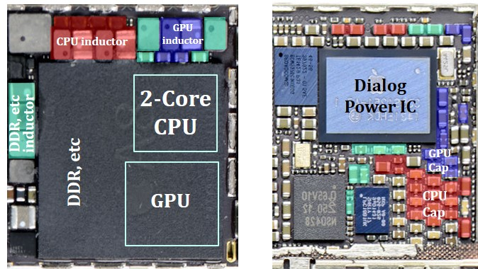
Project Motivation
Develop an open source buck (step down) converter for integration into other projects on the SKY130 PDK
Generate core logic voltage (1.8V) from I/O supply (3.3V)
Reduce system power consumption
Increased integration and reduced PCB complexity
https://cpes.vt.edu/library/viewnugget/623

Slide 3
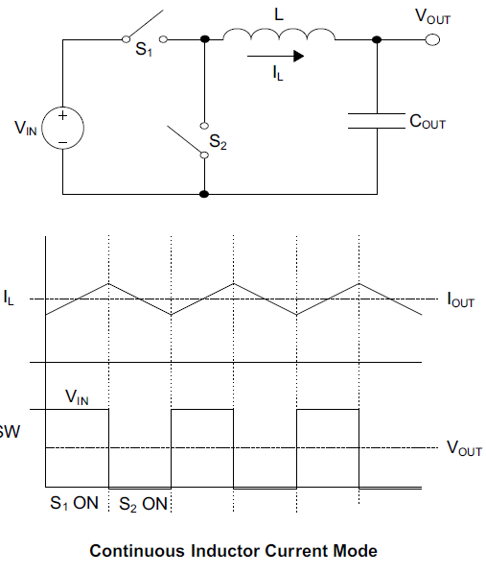
Current Mode Buck Converter Theory
Two switches chop up input voltage and LC filter reconstructs voltage to average value
More stable from a control prospective if control loop regulates inductor current
Requires:
Error amplifier - sense output voltage
Current sensing circuit
Oscillator / modulator - generate switching waveforms
https://microchipdeveloper.com/desanl:synchronous-buck-converter-overview

Slide 4
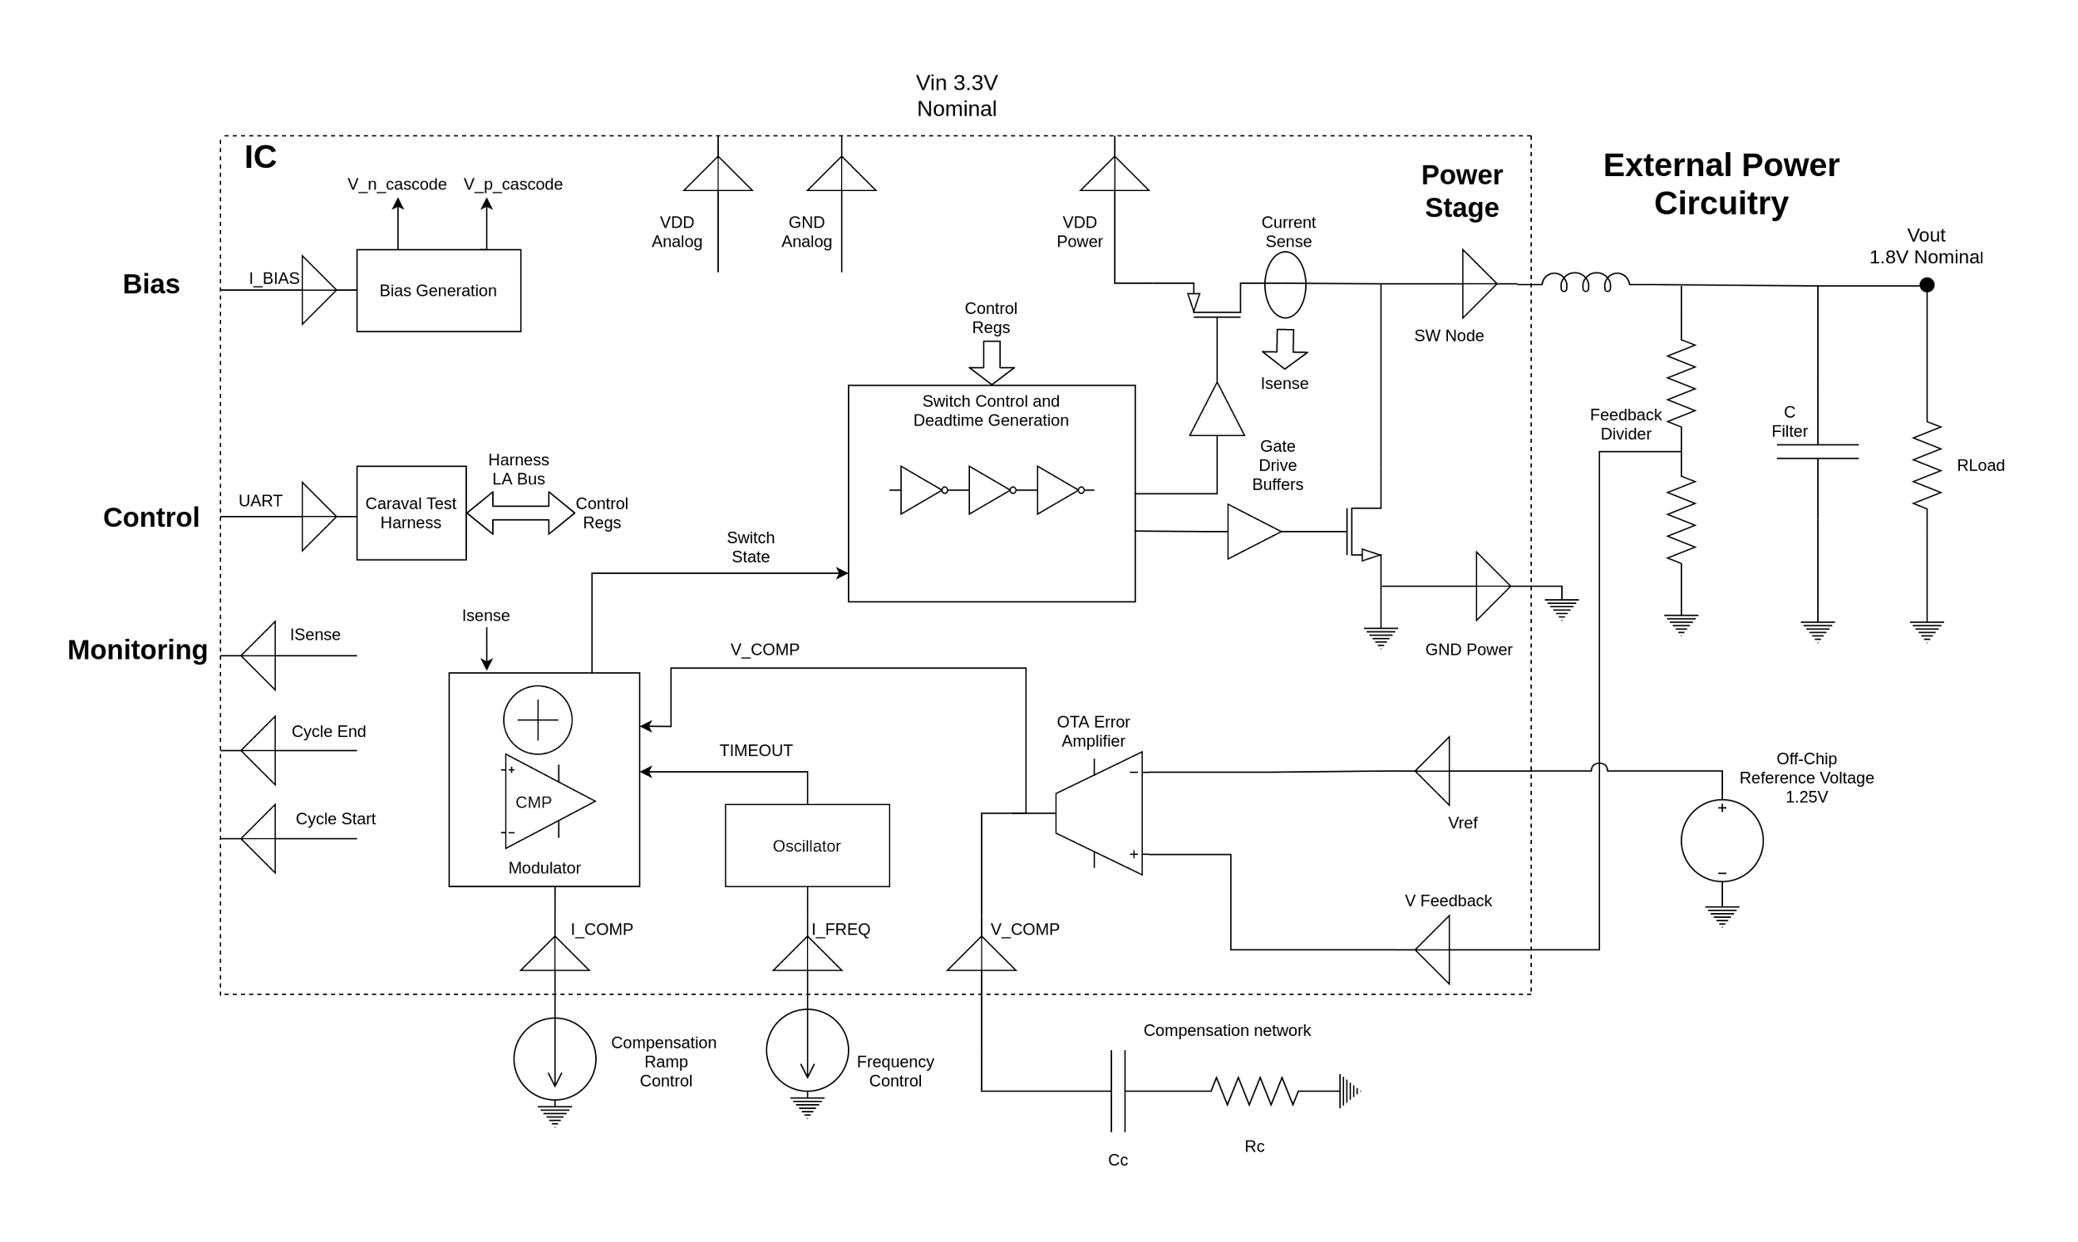
System Block Diagram
Power Circuitry
Support /
Debug
Control
Circuitry

Slide 5
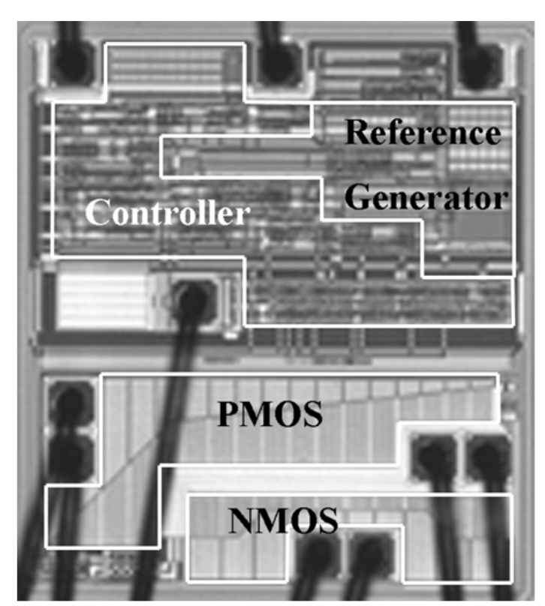
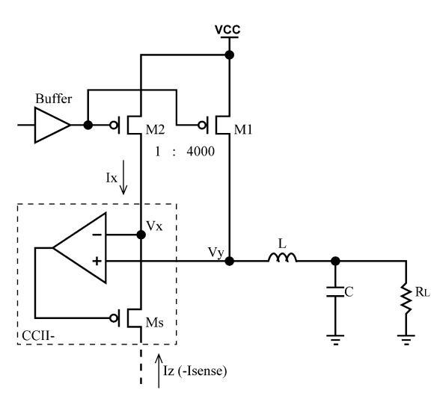
Power Stage + Current Sensing
Large area PMOS and NMOS for power switch
Can measure power PMOS current with ratio sized sense PMOS and feedback circuitry
Derives reference current proportional to size ratio of M1 and M2
F. Ma, W. Chen and J. Wu, "A Monolithic Current-Mode Buck Converter With Advanced Control and Protection Circuits," in IEEE Transactions on Power Electronics, vol. 22, no. 5, pp. 1836-1846, Sept. 2007, doi: 10.1109/TPEL.2007.904237.

Slide 6
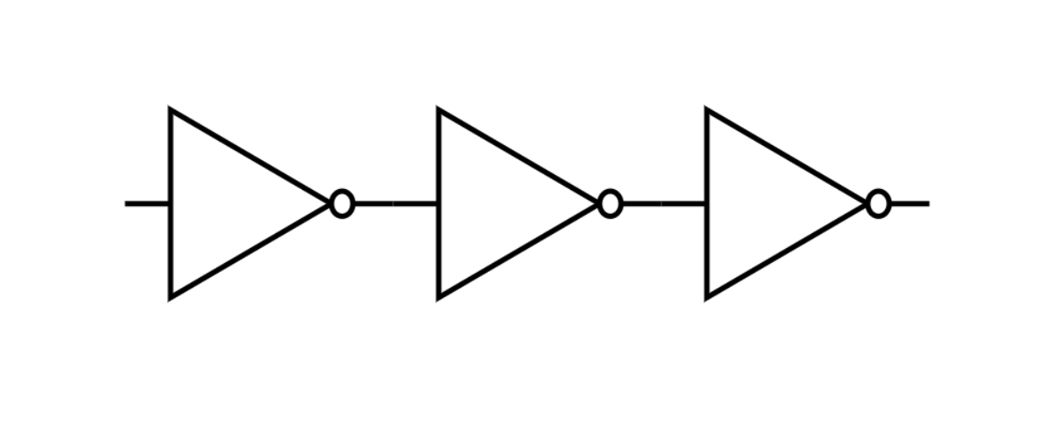
Switch Control And Deadtime Generation
Digital logic with SKY130 5V cell library
Provides deadtime to prevent simultaneous conduction of power stage pmos and nmos
Implemented with chain of inverters, will track required deadtime over PVT
Additional switch control for debug

Slide 7
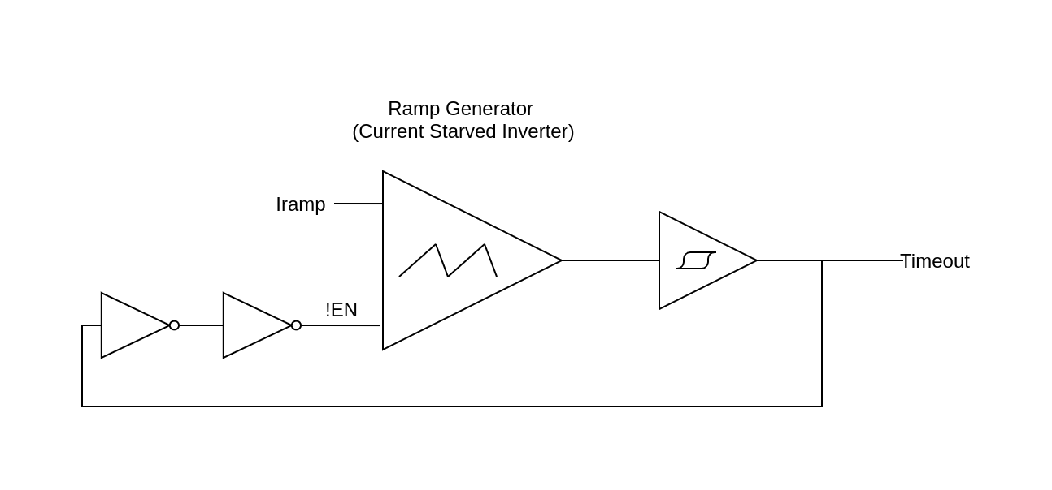
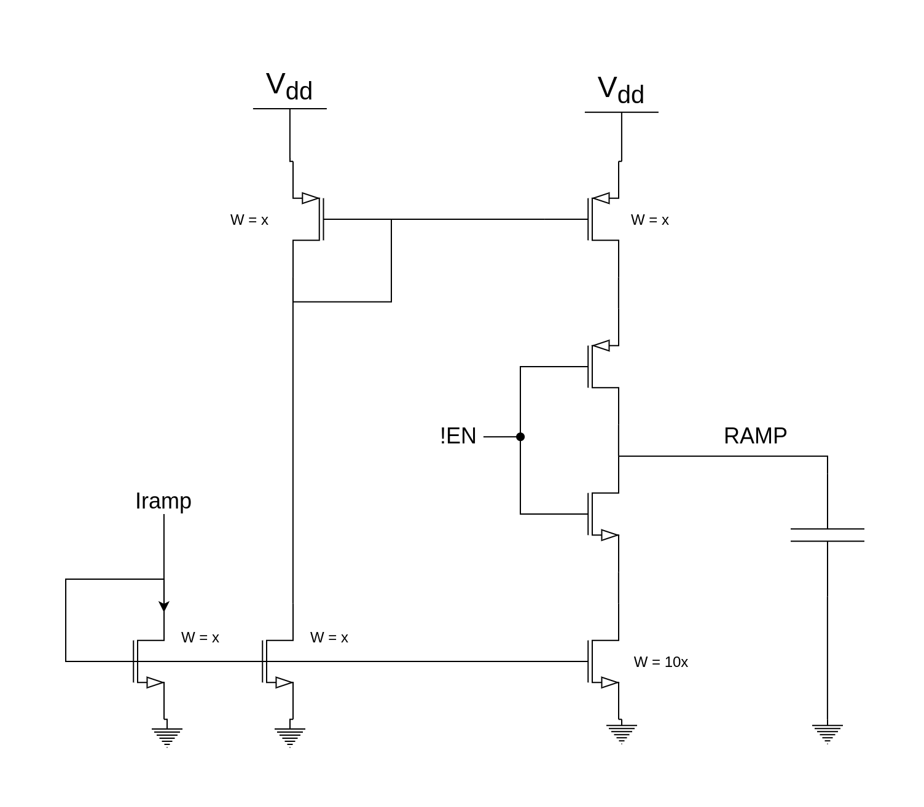
Oscillator
Composed of ramp generator and schmitt trigger
Ramp generator is implemented by a current starved inverter. Slope of ramp and frequency is controlled by Iramp
Schmitt trigger converts the ramp to a square wave, which is fed back as control for the current starved inverter

Slide 8
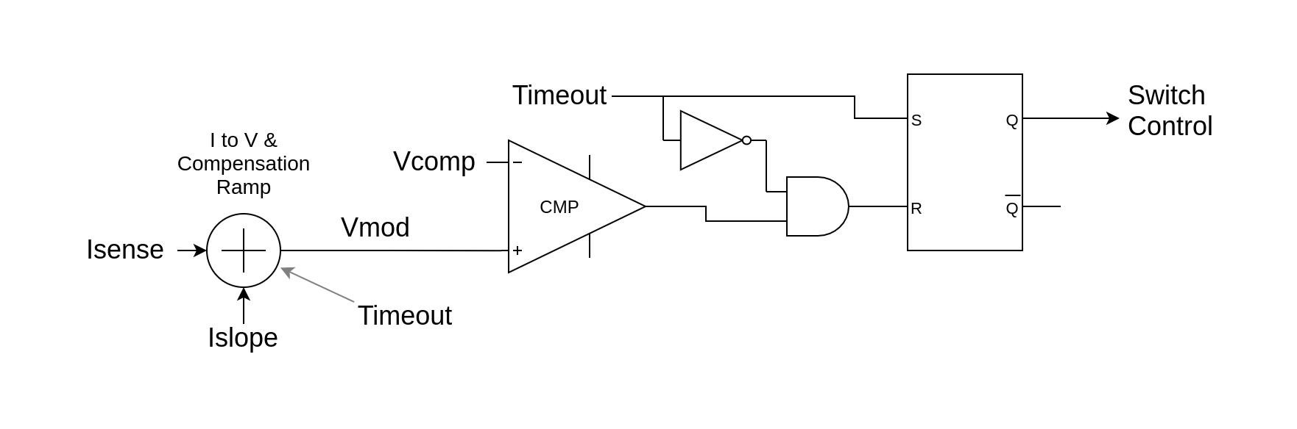
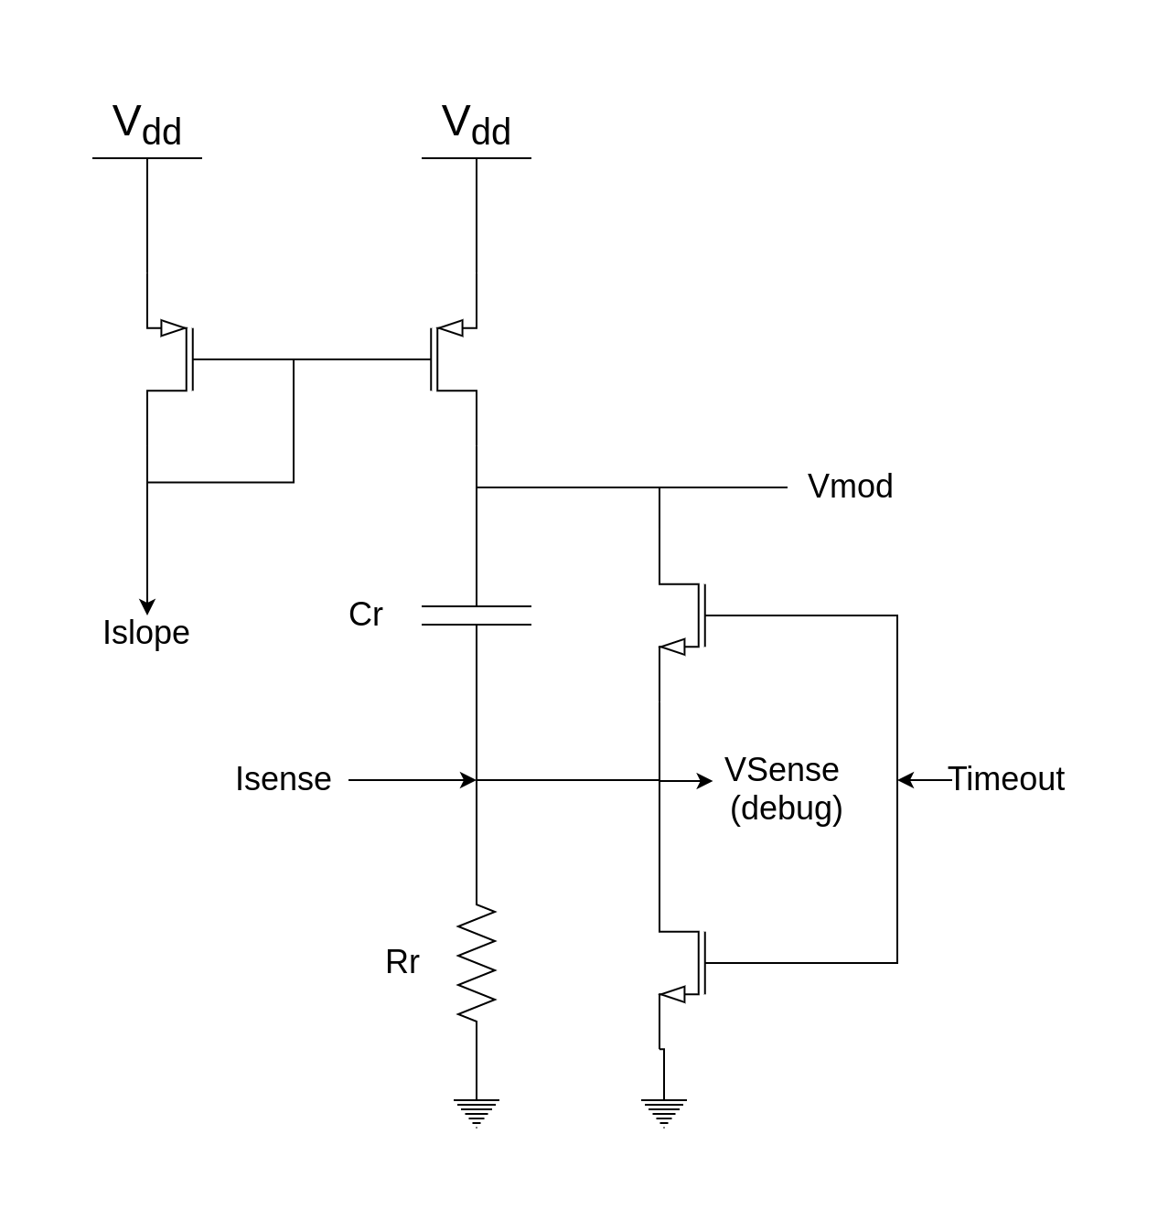
Modulator
Its output controls the switching state of the PMOS and NMOS in the power stage
Subcircuit adds the compensation ramp (controlled by Islope) to Isense, and converts the sum to voltage Vmod
Comparator compares Vmod to Vcomp (output of compensated OTA error amplifier)
Timeout blanks the signal to prevent false triggering due to noise when power stage switches switch

Slide 9
Target Specifications
Nominal Vin | 3.3V
Vout | 1.8V ±5%
Maximum Output Current | 300mA
Switching Frequency | 300Khz
Efficiency | >85%

